Slide 1

DEPARTMENT OF COMPUTER ENGINEERING
Zer Graph
0
Evaluating GraphSAGE for Zero-Day Attack Detection Against ML & DL Baselines
Student Name | Moodle ID | Year – Div
Riya Koli | 23102165 | BE – B
Darsh Jain | 23102037 | BE – B
Amitesh Jain | 23102165 | BE – B
Vaishnavi Khule | 23102017 | BE – B
Under the Guidance of – Prof. Aarthi Kamble

Slide 2
Problem Statement
0
The Core Problem
The Current Gap
Traditional Intrusion Detection Systems (IDS) and standard machine learning models perform reliably when detecting known cyber threats. However, they consistently struggle to identify zero-day attacks unseen vulnerabilities that were never included in the original training data.
A major limitation in current security research is the reliance on conventional, randomized train-test data splits. This methodology fails to simulate real-world cyber environments, where newly deployed threats are completely novel rather than variations of existing training samples.
The Proposed Idea
To address this limitation, this project introduces a novel, realistic zero-day evaluation framework specifically designed to isolate unseen attack classes during testing, simulating true real-world cyber threats. To rigorously validate its efficacy, GraphSAGE's detection accuracy, generalizability, and false-alarm rates are directly benchmarked against established Machine Learning models Random Forest, XGBoost and Deep Learning architectures CNN, LSTM.
Zero Graph

Slide 3
0
bjectives
Develop and train intrusion detection systems using diverse architectures including Random Forest, XGBoost, CNN, LSTM, and GraphSAGE.
Simulate realistic zero-day threats by holding back specific attack classes during training and introducing them exclusively during testing.
Evaluate detection capabilities across all models using standardized metrics like Accuracy, Precision, Recall, F1-Score, ROC-AUC, and Confusion Matrices.
Assess how effectively GraphSAGE generalizes to unobserved threats compared to standard Machine Learning and Deep Learning baselines.
Benchmark proposed frameworks against benchmark cybersecurity datasets, specifically utilizing public repositories like CIC-IDS2017 or CSE-CIC-IDS2018.
Identify and recommend the most effective model architecture for reliable, high-accuracy zero-day threat detection in modern networks.
Zero Graph

Slide 4
Sc pe
0
0
Design and implement an intelligent AI-based Intrusion Detection System (IDS) for network traffic analysis.
Evaluate the capability of GraphSAGE in detecting zero-day (previously unseen) cyber attacks.
Compare Random Forest, XGBoost, CNN, LSTM, and GraphSAGE under the same experimental conditions.
Simulate realistic zero-day scenarios by excluding attack classes during training and evaluating them during testing.
Identify the most effective approach for enhancing zero-day attack detection and strengthening modern cybersecurity systems.
Provide a scalable research framework that can be extended to emerging cyber threats and future intrusion detection systems.
Zero Graph

Slide 5
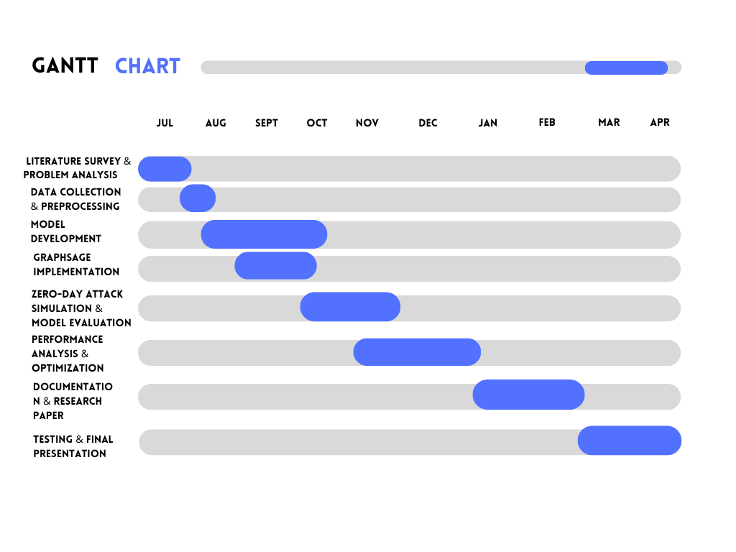
Pr ject Planning & Pr posed Planning
0
0
Zero Graph

Slide 6
Pr p sed Tech Stack
0
0
Core Environment
Programming Language - Python
Development Environments- Visual Studio Code
Operating Systems - Windows
Version Control -
Git & GitHub
AI-ML Frameworks
Traditional ML -
Scikit-learn (Random Forest), XGBoost
Deep Learning -
TensorFlow, Keras CNN, LSTM
Graph Neural Networks - PyTorch Geometric GraphSAGE
Data Handling
Data Processing & Manipulation -
Pandas, NumPy
Data Visualization - Matplotlib, Seaborn
Datasets & Security Data
CS Evaluation Datasets –
CIC-IDS2017
CSE-CIC-IDS2018
Zero Graph

Slide 7
References
[1] W. W. Lo, S. Layeghy, M. Sarhan, M. Gallagher, and M. Portmann, "E-GraphSAGE: A Graph Neural Network Based Intrusion Detection System for IoT," Proc. IEEE/IFIP Network Operations and Management Symposium (NOMS), 2022, doi: 10.1109/NOMS54207.2022.9789878.
[2] W. Hamilton, Z. Ying, and J. Leskovec, "Inductive Representation Learning on Large Graphs," Advances in Neural Information Processing Systems (NeurIPS), vol. 30, 2017.
[3] M. Zhong, M. Lin, C. Zhang, and Z. Xu, "A Survey on Graph Neural Networks for Intrusion Detection Systems: Methods, Trends and Challenges," Computers & Security, vol. 141, p. 103821, 2024, doi: 10.1016/j.cose.2024.103821.
[4] F. Abdullayeva and S. Suleymanzade, "Cyber Security Attack Recognition on Cloud Computing Networks Based on Graph Convolutional Neural Network and GraphSAGE Models," Results in Control and Optimization, vol. 15, p. 100423, 2024, doi: 10.1016/j.rico.2024.100423.

Slide 8
[5] L. Xu et al., "AJSAGE: A Intrusion Detection Scheme Based on Jump-Knowledge Connection to GraphSAGE," Computers & Security, vol. 150, p. 104263, 2025, doi: 10.1016/j.cose.2024.104263.
[6] D.-H. Tran and M. Park, "FN-GNN: A Novel Graph Embedding Approach for Enhancing Graph Neural Networks in Network Intrusion Detection Systems," Applied Sciences, vol. 14, no. 16, p. 6932, 2024, doi: 10.3390/app14166932.
[7] R. Xu et al., "Applying Self-supervised Learning to Network Intrusion Detection for Network Flows with Graph Neural Network," arXiv:2403.01501, 2024.
[8] A. Zoubir and B. Missaoui, "Integrating Graph Neural Networks with Scattering Transform for Anomaly Detection," arXiv:2404.10800, 2024.
[9] I. Sharafaldin, A. H. Lashkari, and A. A. Ghorbani, "Toward Generating a New Intrusion Detection Dataset and Intrusion Traffic Characterization," Proc. ICISSP, 2018.
[10] Canadian Institute for Cybersecurity, "CIC-IDS2017 Dataset," University of New Brunswick, 2017.
[11] N. Moustafa, "TON_IoT Telemetry Dataset: A New Generation Dataset of IoT and IIoT for Data-Driven Intrusion Detection Systems," IEEE Access, vol. 8, pp. 165130–165150, 2020.

Slide 9
[13] N. Koroniotis, N. Moustafa, E. Sitnikova, and B. Turnbull, "Towards the Development of Realistic Botnet Dataset in the Internet of Things for Network Forensic Analytics," Future Generation Computer Systems, vol. 100, pp. 779–796, 2019.
[14] T. Chen and C. Guestrin, "XGBoost: A Scalable Tree Boosting System," Proc. ACM SIGKDD, 2016.
[15] L. Breiman, "Random Forests," Machine Learning, vol. 45, no. 1, pp. 5–32, 2001.
[16] S. Hochreiter and J. Schmidhuber, "Long Short-Term Memory," Neural Computation, vol. 9, no. 8, pp. 1735–1780, 1997.
[17] Y. LeCun, Y. Bengio, and G. Hinton, "Deep Learning," Nature, vol. 521, no. 7553, pp. 436–444, 2015.
[18] D. Pujol-Perich, J. Suárez-Varela, A. Cabellos-Aparicio, and P. Barlet-Ros, "Unveiling the Potential of Graph Neural Networks for Robust Intrusion Detection," arXiv:2107.14756, 2021.
[19] M. L. Kazimoto, J. S. Ally, and S. Leonard, "A Hybrid LSTM-GNN-Q-Learning Model for Zero-Day Attack Detection: Evaluation on CICIDS2017 with Simulated Zero-Day Setting," Journal of Information Systems and Informatics, vol. 8, no. 3, 2025.
[20] A. L. Buczak and E. Guven, "A Survey of Data Mining and Machine Learning Methods for Cyber Security Intrusion Detection," IEEE Communications Surveys & Tutorials, vol. 18, no. 2, pp. 1153–1176, 2016.

Slide 10
SDG Goals
SDG 9 – Industry, Innovation and Infrastructure
Develops an AI-based intrusion detection system to strengthen secure and resilient digital infrastructure.
SDG 16 – Peace, Justice and Strong Institutions
Enhances cybersecurity by improving the detection of emerging and zero-day cyber threats.
SDG 8 – Decent Work and Economic Growth
Reduces cyber risks and supports secure digital business operations.
SDG 11 – Sustainable Cities and Communities
Improves the security of smart city networks and connected digital services.
SDG 17 – Partnerships for the Goals
Promotes collaborative AI and cybersecurity research using publicly available datasets.
Zero-Day Cyber Attack Detection Using Graph Neural Networks

